Slide 1
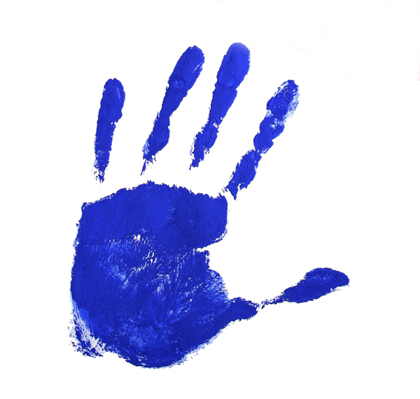
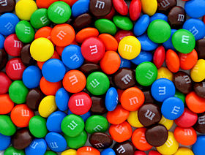
Hands on Experiment
Alycia Scarpelli

Slide 2
Goals
Students will explore characteristics of various forms of measurement.
Students will discover and apply relationships among various forms of measurement.

Slide 3
Objectives
Given various measurement tools, students will identify and use them to measure, with 90% accuracy.
Given various measurement tools and M&M’s, students will determine equivalency among the forms of measurement, with 90% accuracy.
Given measurement data, students will compute conversions using ratios and proportions, with 90% accuracy.

Slide 4
Materials
Containers
In ounces, cup, pint, quart, & gallon size
M&M’s
Milk Chocolate sized
Handout
Data Chart

Slide 5
Warm up
What size containers do you usually use/buy?
What is in such containers?

Slide 6
Let’s see what you know…
How many ounces are in a cup?
8 ounces = 1 cup
How many cups are in a pint?
2 cups = 1 pint
How many pints are in a quart?
2 pints = 1 quart
How many quarts are in a gallon?
4 quarts = 1 gallon

Slide 7
Procedure
1. We are going to get into three groups of equal size.
2. Each group will receive measuring tools and m&m’s.
3. Put as many m&m’s as it takes to fill the specified
amount (on data chart).
4. Estimate the amount of m&m’s in the container.
5. Count the amount of m&m’s it takes to fill such an
amount.
6. Record your data on the chart provided: There are
_____ m&m’s in a ________.
(example: There are 6 m&m’s in one tablespoon)
7. Repeat this process until you have completed the
data chart.

Slide 8
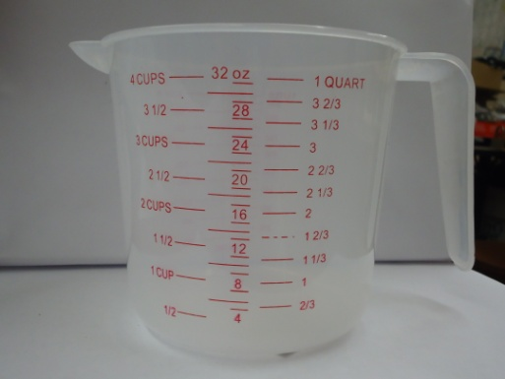
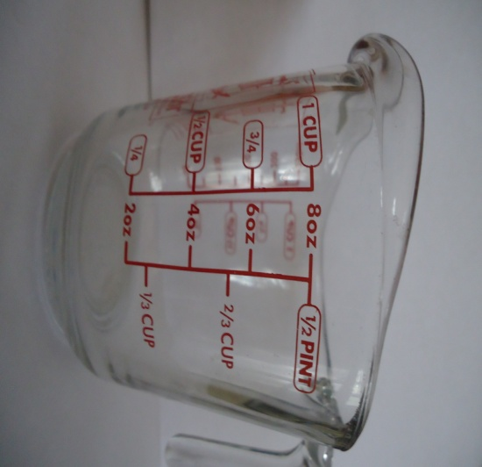
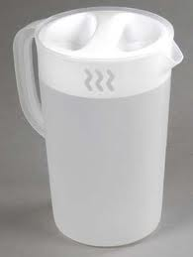
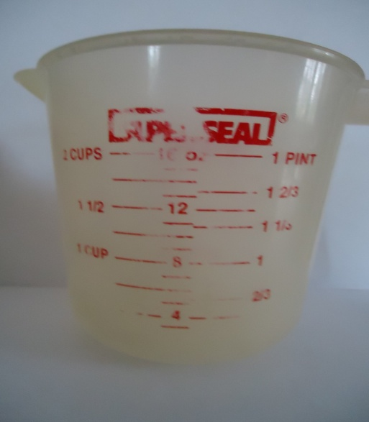
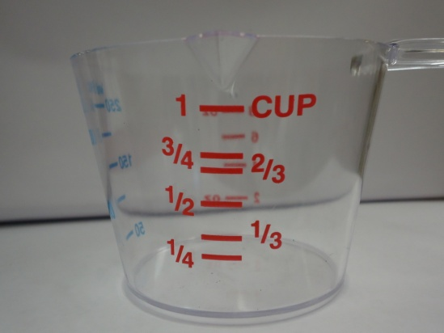
Collect Materials

Slide 9
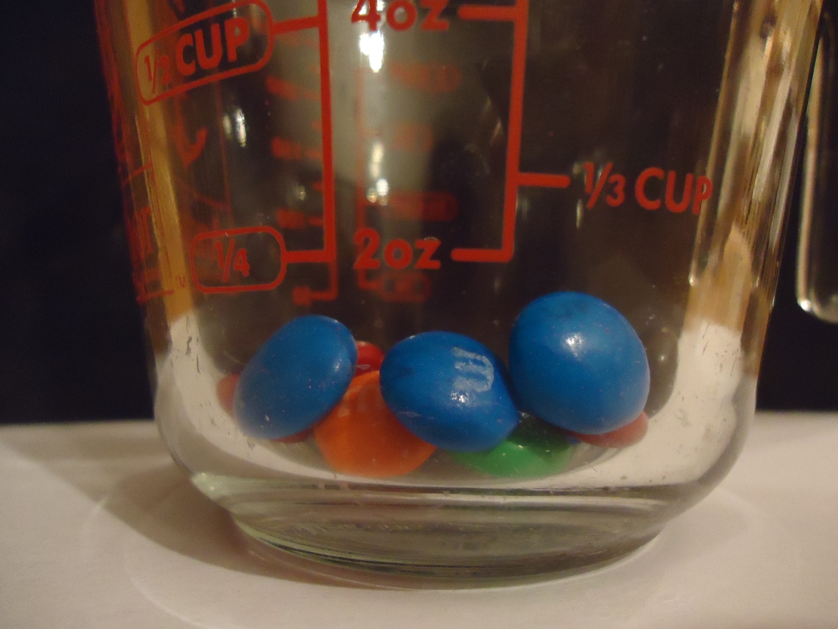
How many m&m’s does it take to fill 1 ounce?

Slide 10
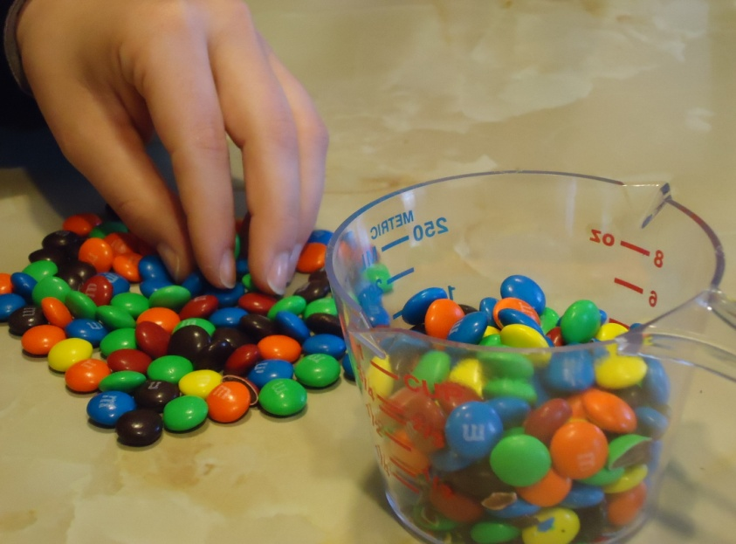
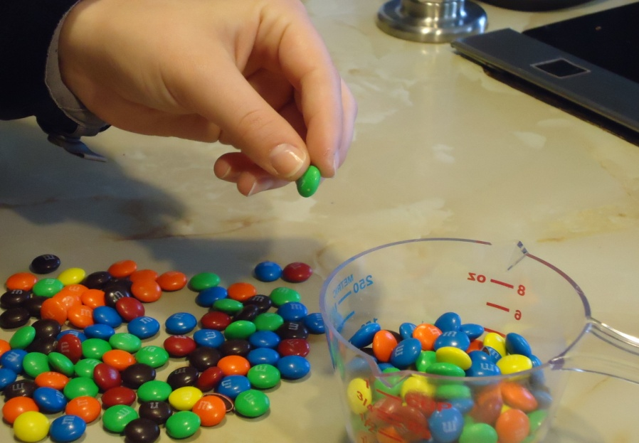
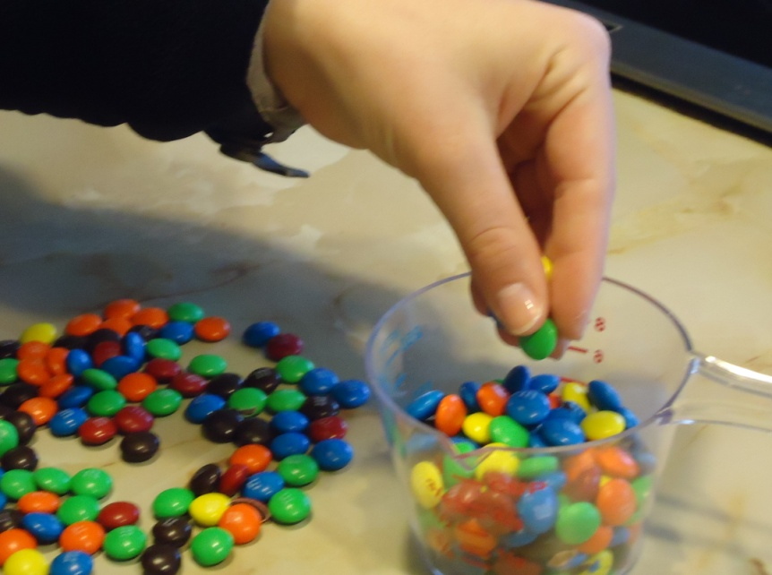
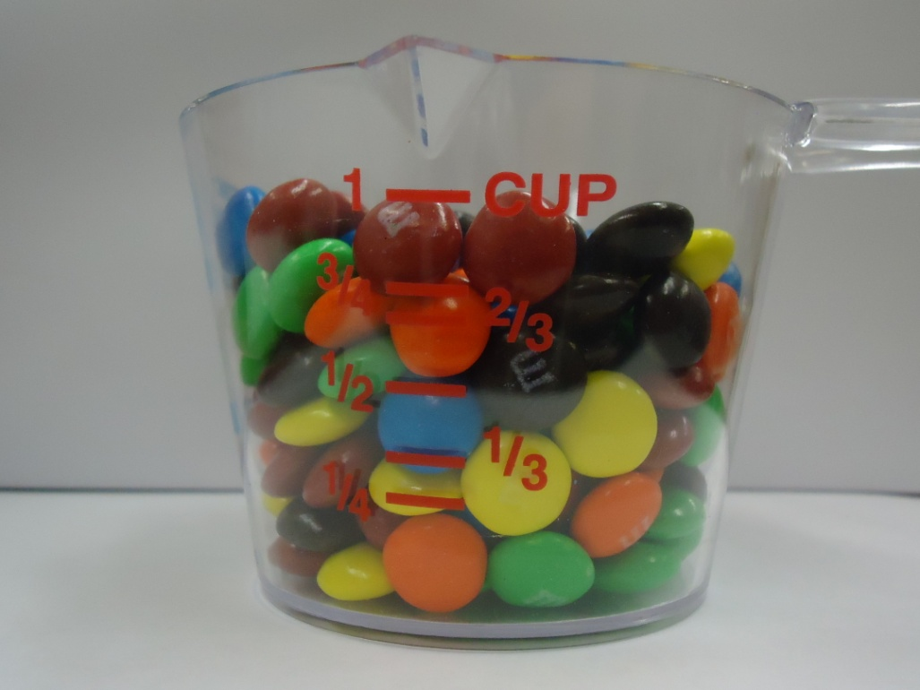
How many m&m’s does it take to fill 1 cup?

Slide 11
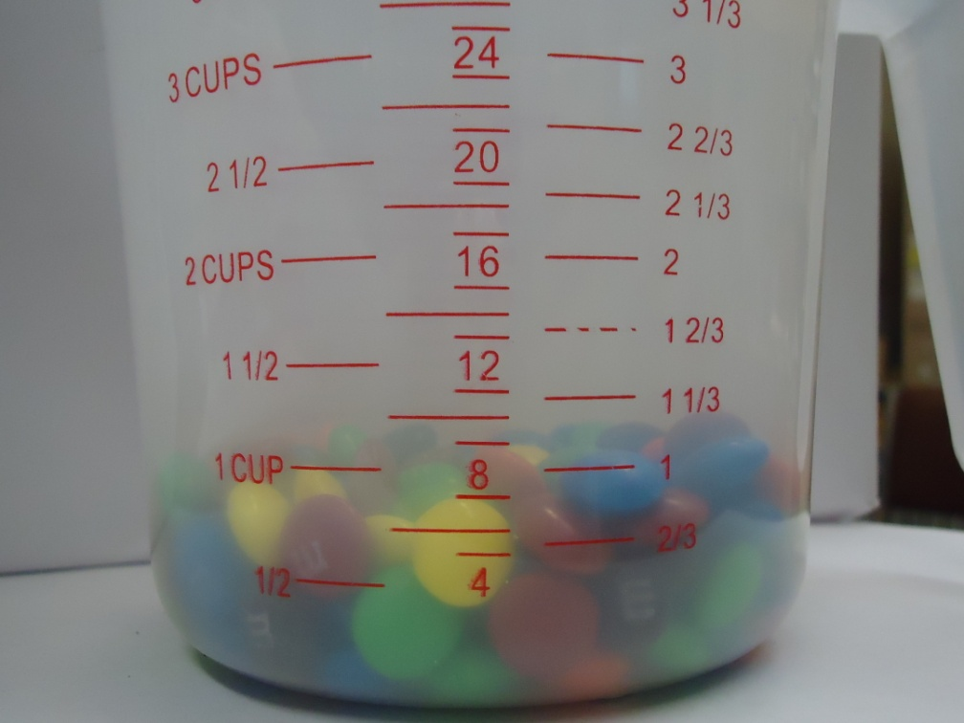
1 cup

Slide 12
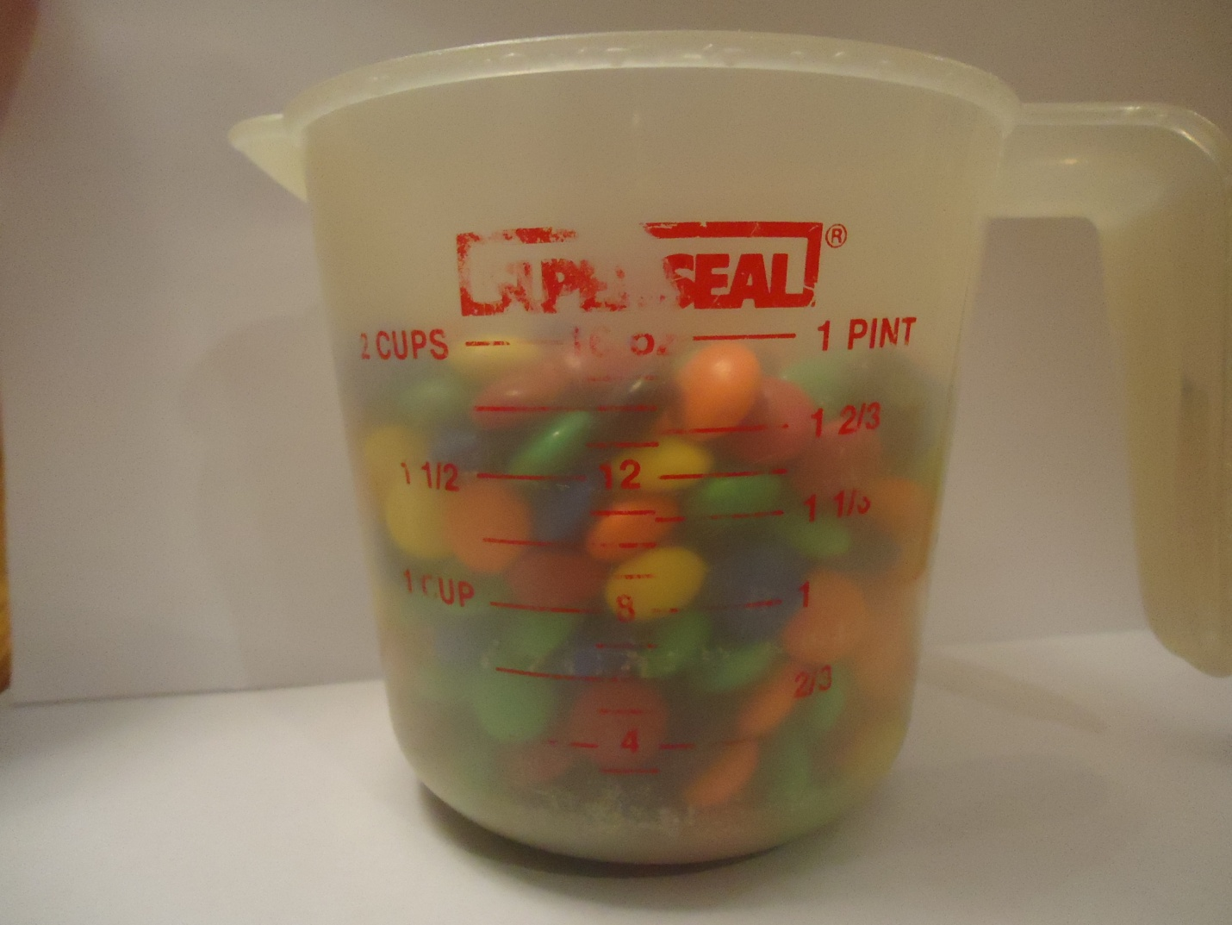
How many m&m’s does it take to fill 1 pint?

Slide 13
How many m&m’s does it take to fill 1 quart?

Slide 14
How many m&m’s does it take to fill 1 gallon?

Slide 15
How many m&m’s do you think are in…?
Form of Measurement | Estimated amount of m&m’s | Actual amount of m&m’s
1 ounce
1 cup
1 pint
1 quart
1 gallon

Slide 16
How many m&m’s do you think are in…? (estimated by a seventh grader)
Form of Measurement | Estimated amount of m&m’s | Actual amount of m&m’s
1 ounce | 25
1 cup | 150
1 pint | 300
1 quart | 615
1 gallon | 3000

Slide 17
Estimates vs. Actual
Form of Measurement | Estimated amount of m&m’s | Actual amount of m&m’s
1 ounce | 25 | 25
1 cup | 150 | 222
1 pint | 300 | 435
1 quart | 615 | 878
1 gallon | 3000 | -

Slide 18
Let’s Analyze the Data
To find the number of m&m’s in various forms of measurement, we can make connections with the forms of measurements/ results we have already used.
Rather than counting the m&m’s, can we use a mathematical method?
Form of Measurement | Estimated amount of m&m’s | Actual amount of m&m’s
1 ounce | 25 | 25
1 cup | 150 | 222
1 pint | 300 | 435
1 quart | 615 | 878
1 gallon | 3000 | -

Slide 19
What about Ratios and Proportions?
What is a ratio?
A ratio is a comparison of two similar quantities obtained by dividing one quantity by the other. Ratios are written with the : symbol.
What is a proportion?
A proportion is a statement of the equality of two ratios. a : b = c : d or a / b = c / d
How can we use ratios and proportions to find the number of m&m’s in various units of measurement?

Slide 20
Earlier, we said that…
8 ounces = 1 cup
2 cups = 1 pint
2 pints = 1 quart
4 quarts = 1 gallon
How can these be written as ratios?
8 ounces : 1 cup
2 cups : 1 pint
2 pints : 1 quart
4 quarts : 1 gallon

Slide 21
Now, we can use proportions…
We can use the proportion below to estimate the total number of m&m’s in 4 cups:
Amount/Unit of measurement (looking to find) = Known amount/ same unit of measurement
# of m&m’s (unknown) # of m&m’s in associated unit of measurement (known)
(We know 1 cup contains 222 m&m’s.)
4 cups = 1 cup
x 222 m&m’s
1(x) = 222(4)
x = 888
There are 888 m&m’s in 4 cups.

Slide 22
In Proportions…
Product of extremes = Product of the means
Example:
4 cups = 1 cup
888 m&m’s 222 m&m’s
4(222) = 1(888)
888 = 888

Slide 23
Let’s try some more…
Using proportions…
Determine the number of m&m’s in ¾ cup.
¾ cup = 1 cup
x 222 m&m’s
1(x) = 222(3/4)
x = 166.5
There are 166.5 m&m’s in 3/4 cups.
Determine the number of m&m’s in 1 gallon.
How many cups are in a gallon? If 4 quarts equal 1 gallon, and we know that 4 cups equal 1 quart. Then, 16 cups = 1 gallon.
16 cups = 1 cup
x 222 m&m’s
1(x) = 222(16)
x = 3552
There are 3552 m&m’s in 16 cups = 1 gallon.

Slide 24
Data Chart
Using 1 cup = 222 m&m’s, we found…
Form of Measurement | Actual amount of m&m’s (counted) | Amount of m&m’s found using proportions
1 ounce | 25 | 27.75
¾ cup | - | 166.5
1 cup | 222 | 222
1 pint | 435 | 444
1 quart | 878 | 888
1 gallon | - | 3552

Slide 25
Percent Error
How close were your approximations (using proportions) to the actual number of m&m’s in the given forms of measurements?
Approximated value – Actual Value
Actual Value
888-878
878
X 100%
Form of Measurement | Actual amount of m&m’s (counted) | Amount of m&m’s found using proportions
1 quart | 878 | 888
X 100% = 1.14 %

Slide 26
Connections
In what types of situations might ratios/proportions be helpful?
Cooking / Recipes
Percent problems
Scale maps and drawings
Similar triangles

Slide 27
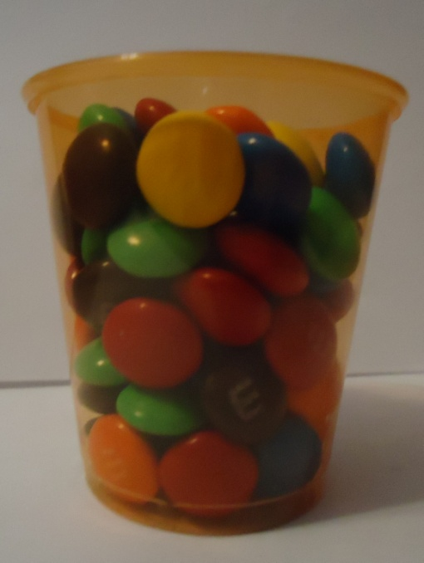
Another question:
Estimate how many m&m’s are
in the container
Use a proportion to approximate the amount of m&m’s in the container.
Count the m&m’s in the container
Compare your estimated number, approximated number (using proportions), and actual number of m&m’s in the 3 ounce container.

Slide 28
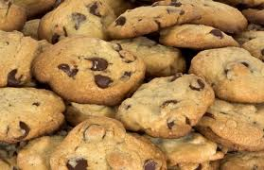
For Fun…
The following recipe makes 48 cookies:
CHOCOLATE CHIP COOKIES
1 1/2 sticks butter (12 tablespoons)
1 cup light brown sugar, firmly packed
1/2 cup white granulated sugar
2 eggs, lightly beaten
2 1/4 cups sifted flour
1/2 tsp. salt
1 tsp. baking soda
1 1/2 tsp. pure vanilla extract
1 cup nuts, chopped
1/2 cup golden raisins, soaked in hot water (optional)
1 cup semi-sweet morsels
Make enough dough for 36 people , providing each person gets 2 cookies.
http://www.cooks.com/rec/view/0,1610,147188-235198,00.html

